Slide 1
English
Unit 2 – Sport
WALT:
6Ug.09 Begin to use if clauses in first conditionals.

Slide 2



WALT: Begin to use if clauses in first conditionals.
I can complete sentences in the first conditional.
I can write my own sentences in the first conditional.
I can write my own sentences in all the different forms of the first conditional.

Slide 3
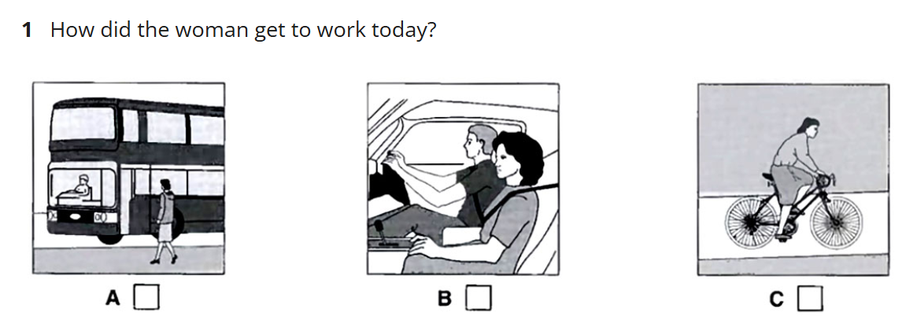
Retrieval Practice
WALT: Begin to use if clauses in first conditionals.
https://englishpracticetest.net/practice-listening-test-for-b1-with-answer-and-audioscript-test-11/

Slide 4
Starter – What is wrong with the sentences?
WALT: Begin to use if clauses in first conditionals.
If he work hard he will be a great athlete.
Brush your teeth unless you’ll have rotting teeth.

Slide 5
Starter – What is wrong with the sentences?
WALT: Begin to use if clauses in first conditionals.
If he works hard, he will be a great athlete.
If you don’t brush your teeth, you’ll have rotting teeth.

Slide 6
TTYP – What is the first conditional?
WALT: Begin to use if clauses in first conditionals.
The first conditional is used to refer to a likely outcome to a present or future situation.
If he works hard, he will be a great athlete.
Present or future situation.
Likely outcome.

Slide 7
WALT: Begin to use if clauses in first conditionals.
The first conditional
Modelling
If + present simple + then + future simple.

Slide 8
You can also use “unless” instead of “if you don’t”.
WALT: Begin to use if clauses in first conditionals.
The first conditional
If you don’t eat a balanced diet, you will become unhealthy.
Unless eat a balanced diet, you will become unhealthy.
You will become unhealthy unless eat a balanced diet.
.

Slide 9
WALT: Begin to use if clauses in first conditionals.
Complete the sentences using the first conditional.
Write your own sentences using the first conditional.
Write your own sentences using all the different forms of the first conditional.

Slide 10
Read your partner’s sentences.
WALT: Begin to use if clauses in first conditionals.
Be prepared to read your favourite to the class and justify why it’s your favourite.
If you work hard, we will have time to play a game.

